Slide 1

Annual Resident Survey Results
2025

Slide 2
Survey Summary
Residential Living 79.8% - 254 respondents
Bridgewater 85.5% - 62 respondents
Springwater 91.4% - 19 respondents
Edgewater 77.5% - 82 respondents
Home Health 79.4% - 60 respondents
Summary: 82.7%

Slide 3
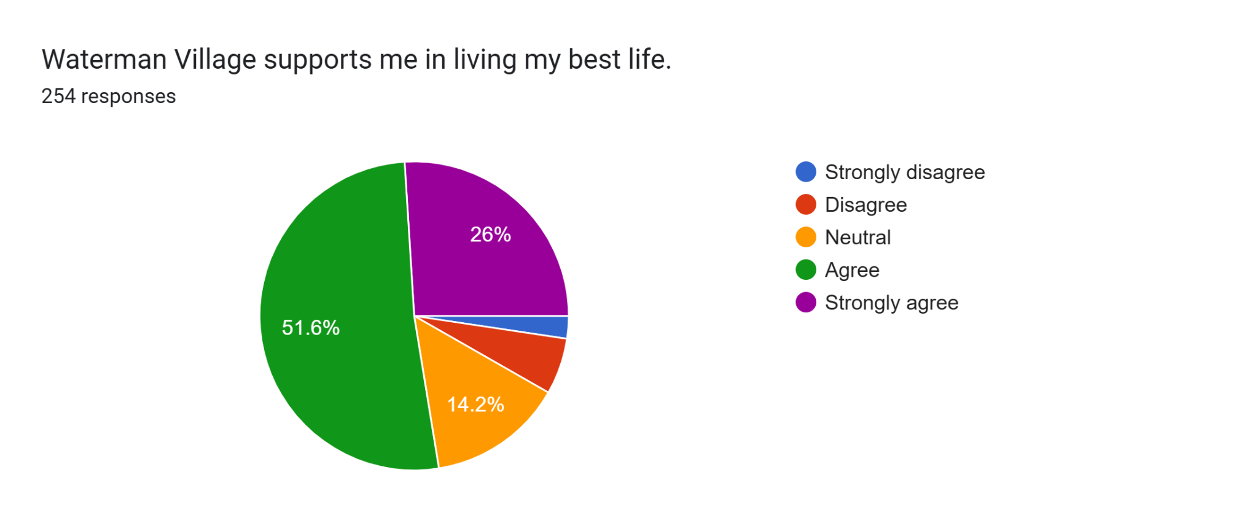

Slide 4
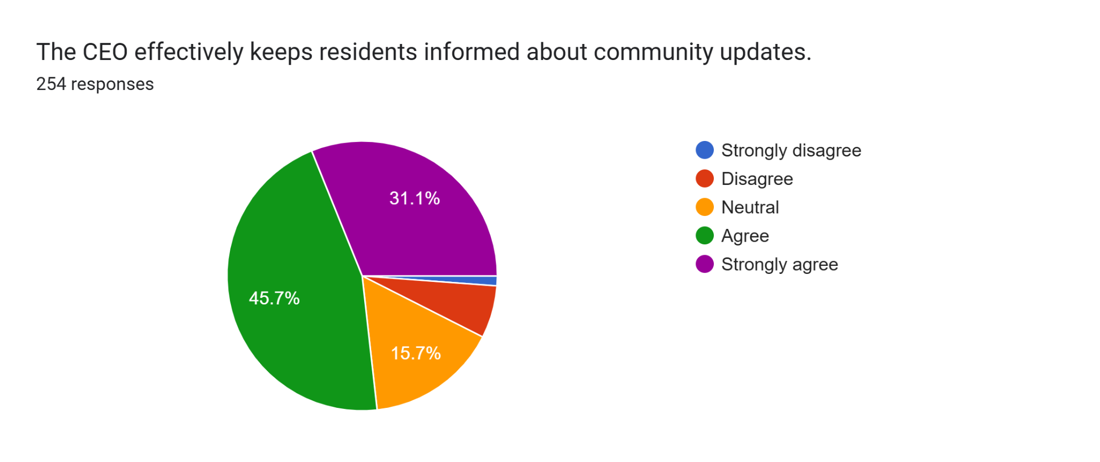

Slide 5
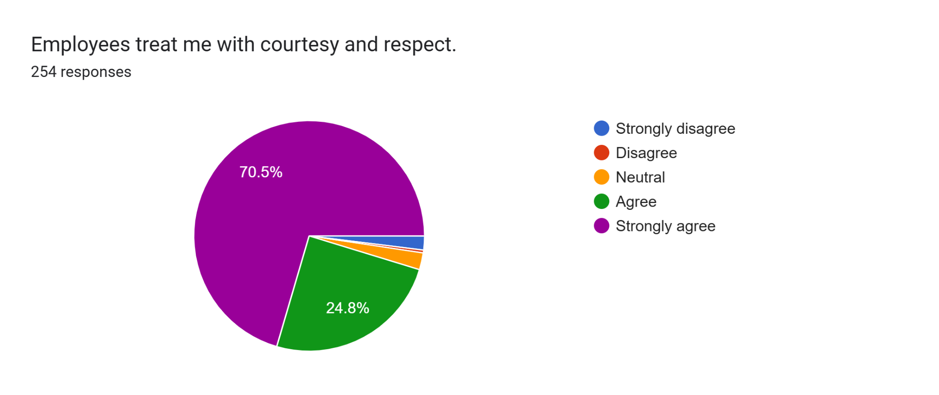

Slide 6
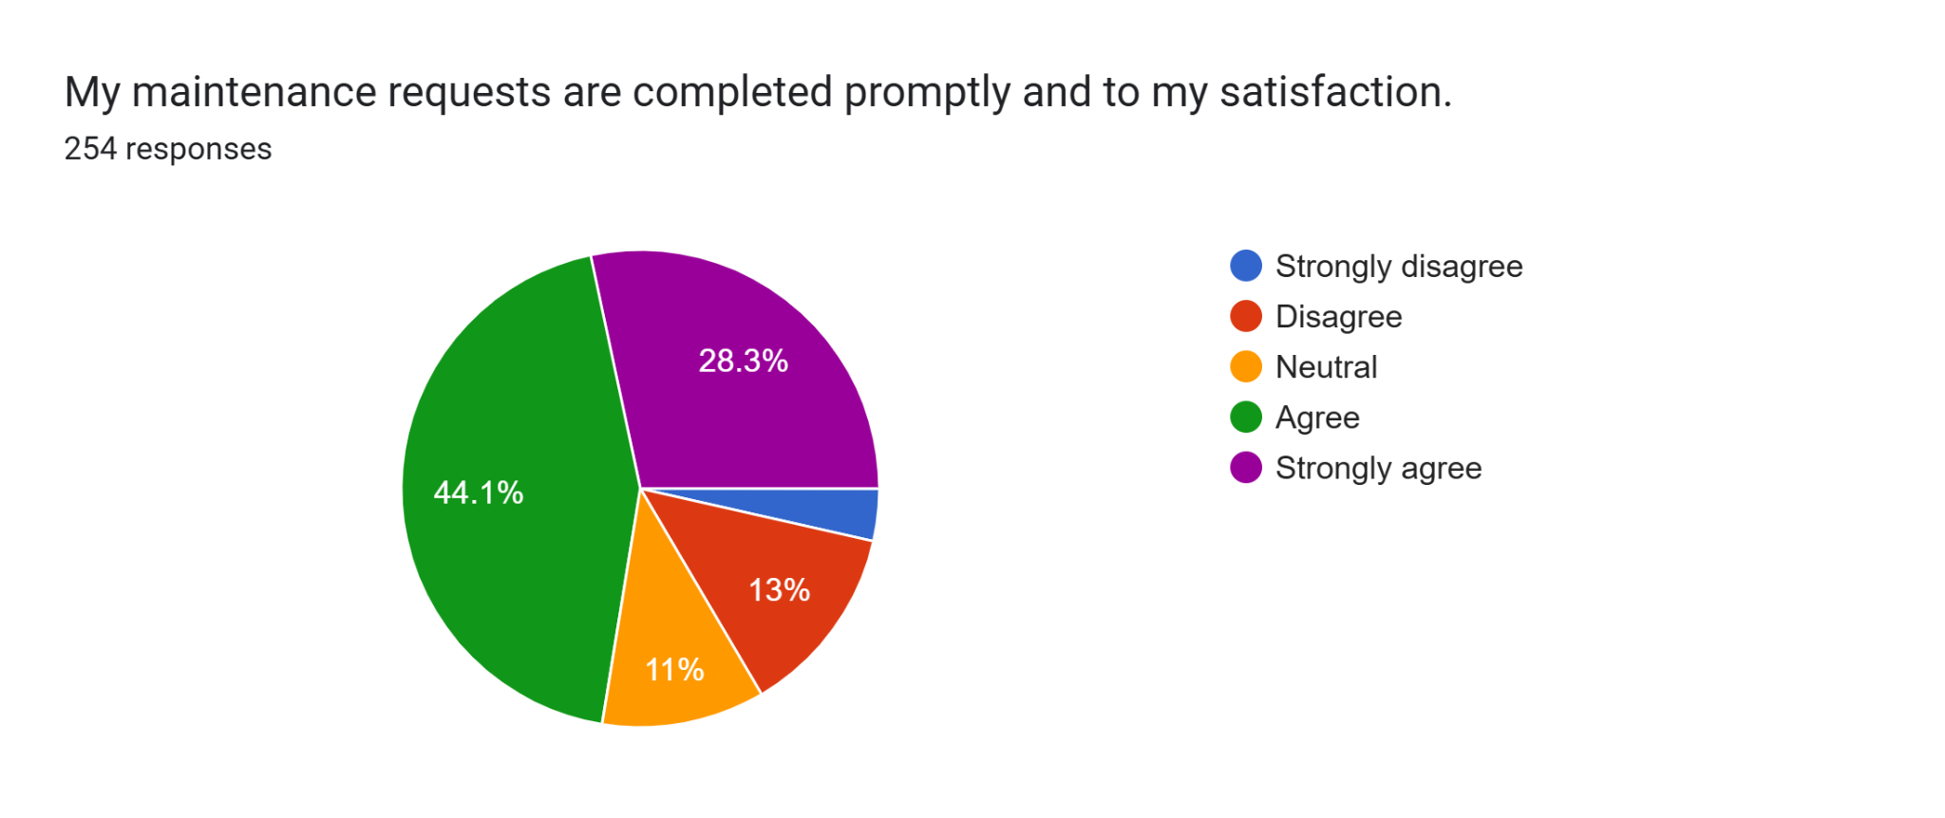

Slide 7
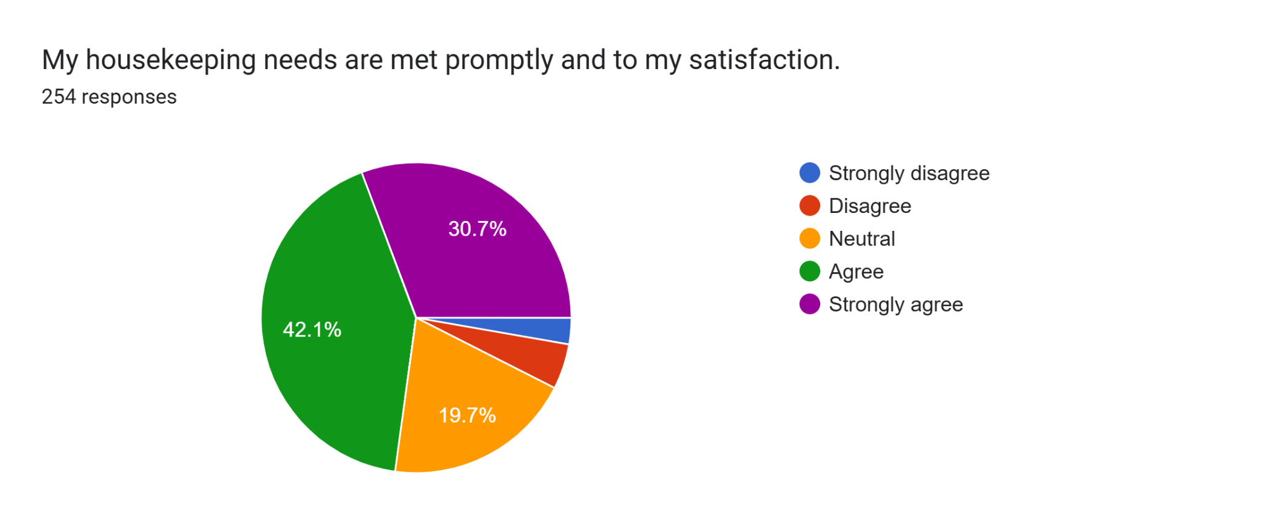

Slide 8


Slide 9
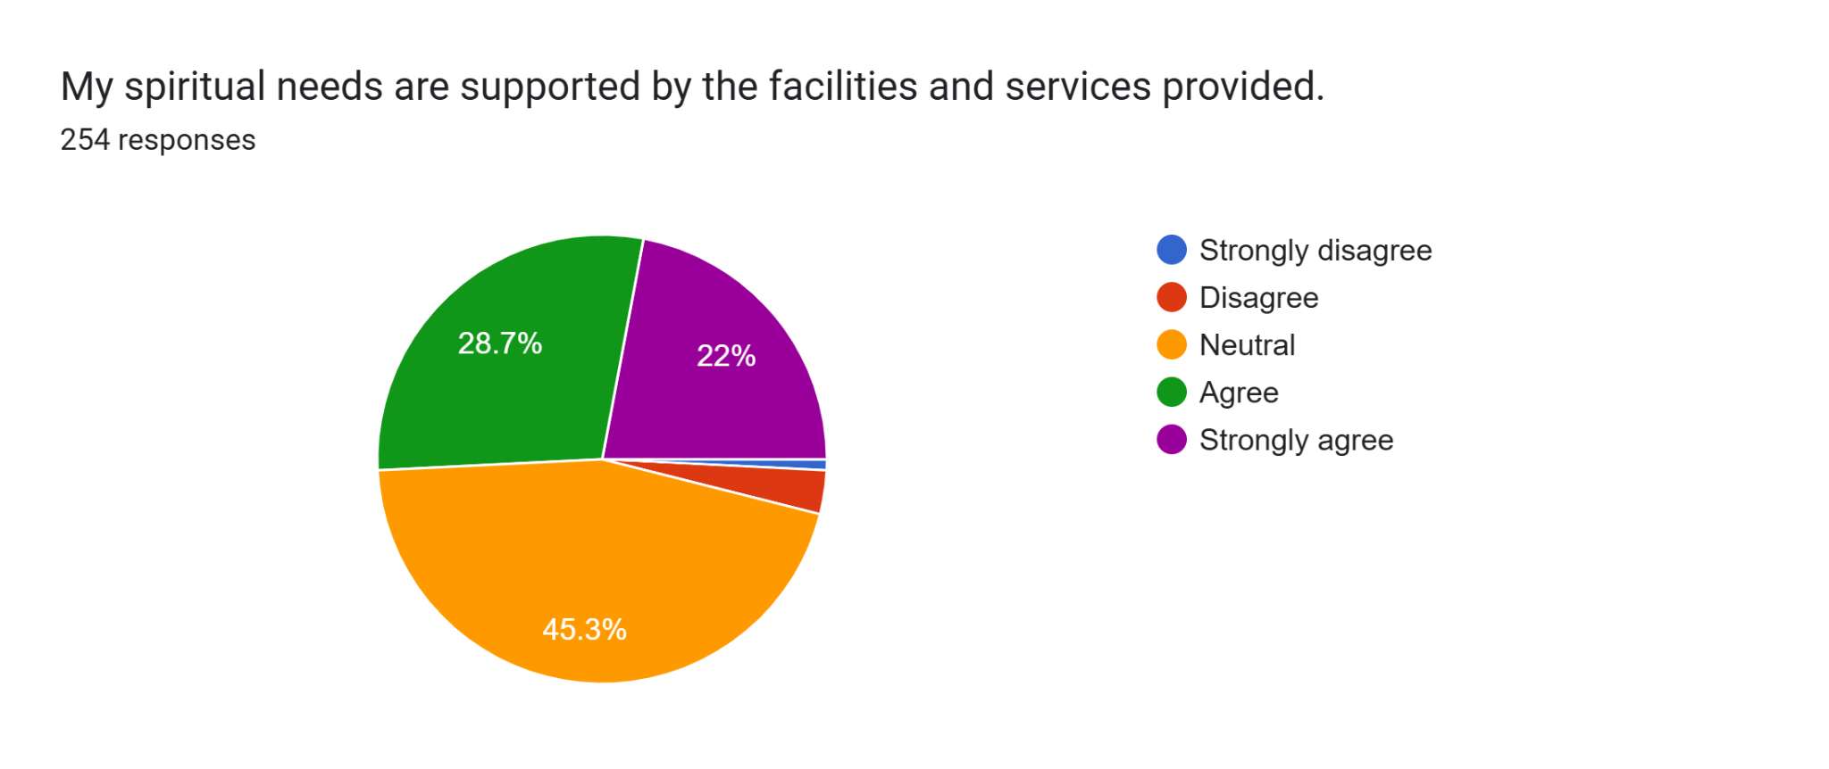

Slide 10
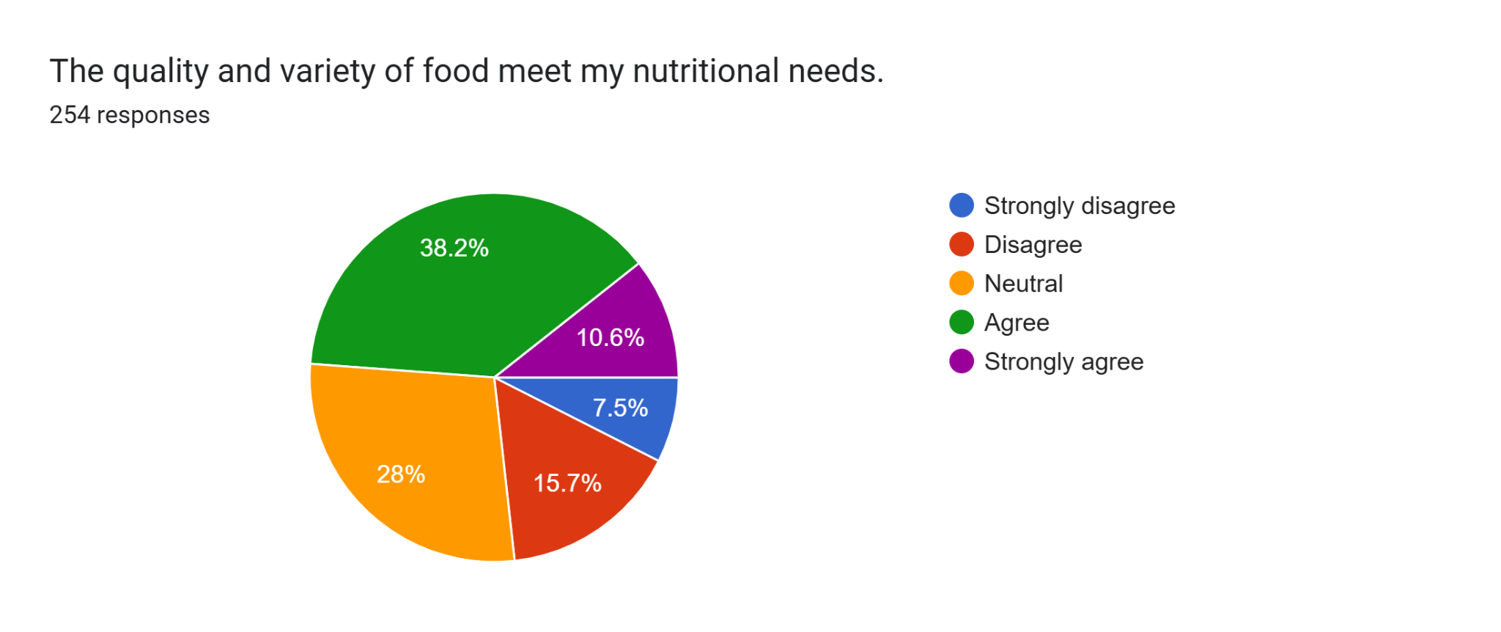

Slide 11
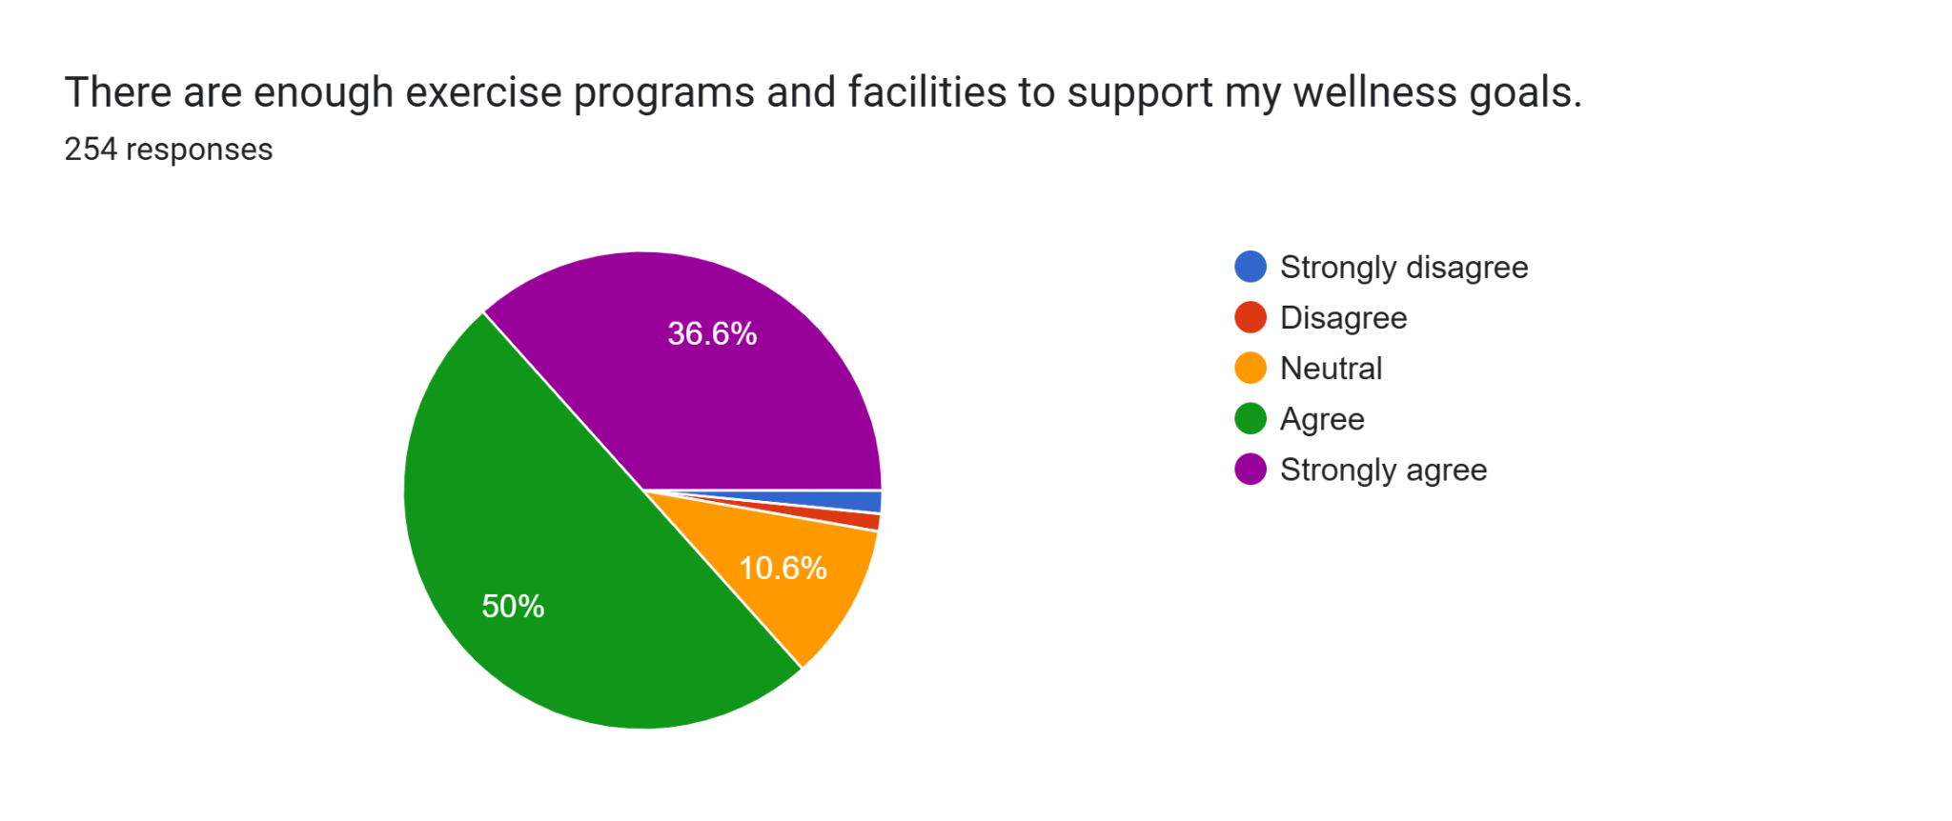

Slide 12


Slide 13
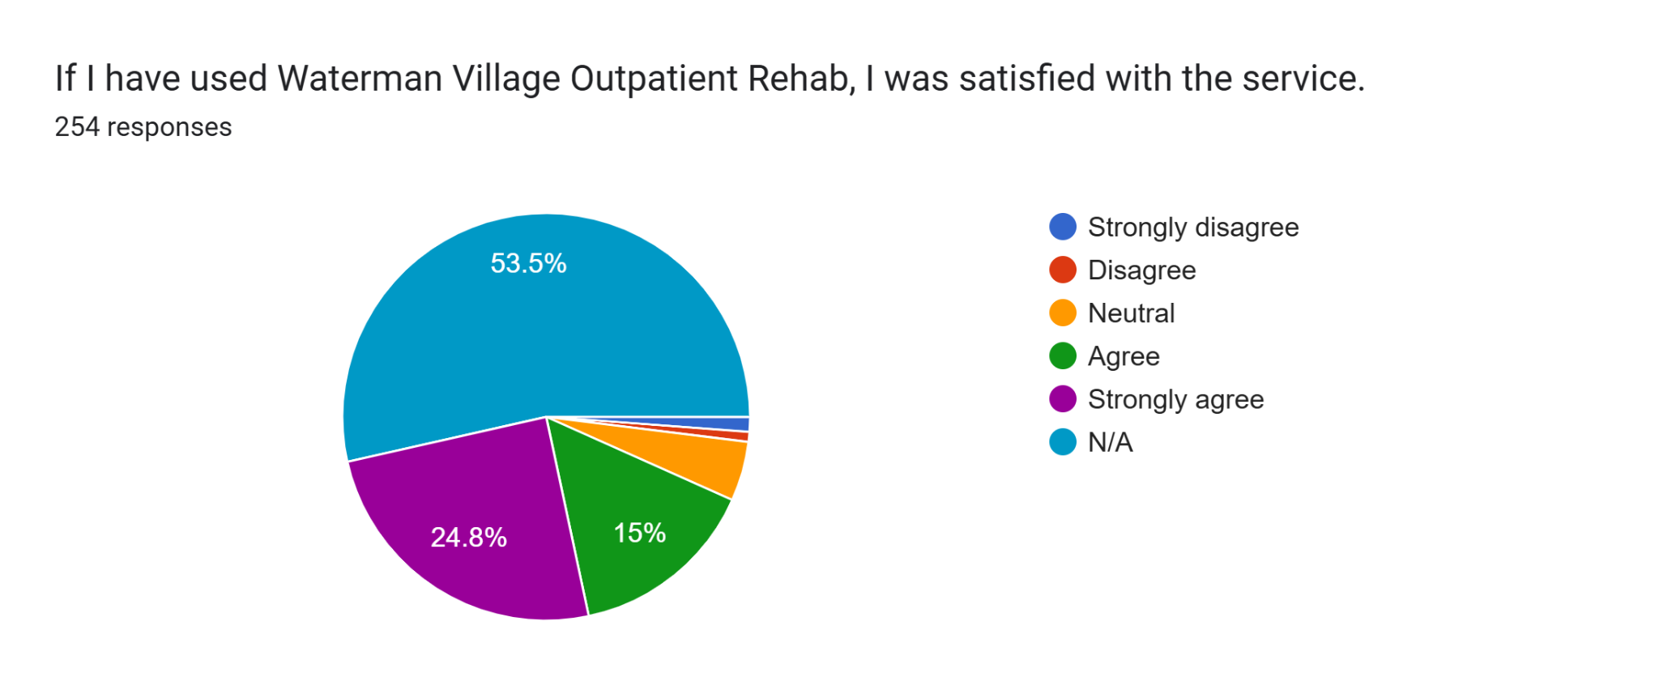

Slide 14
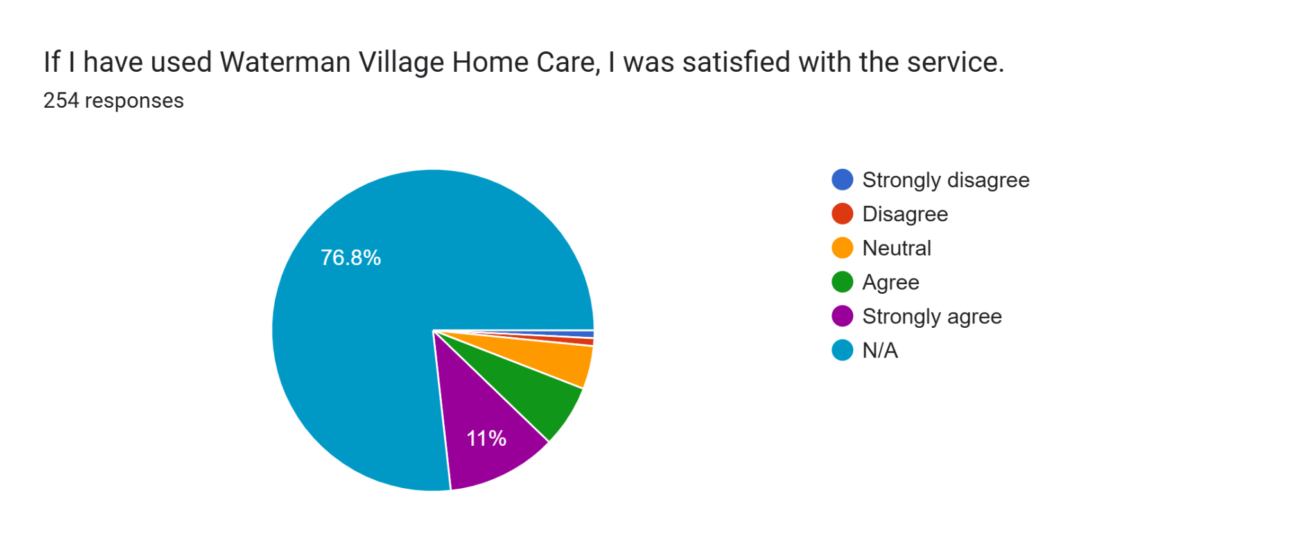

Slide 15
