Slide 1

Amenities Used by Guests and Wait List Members Survey Results

Slide 2
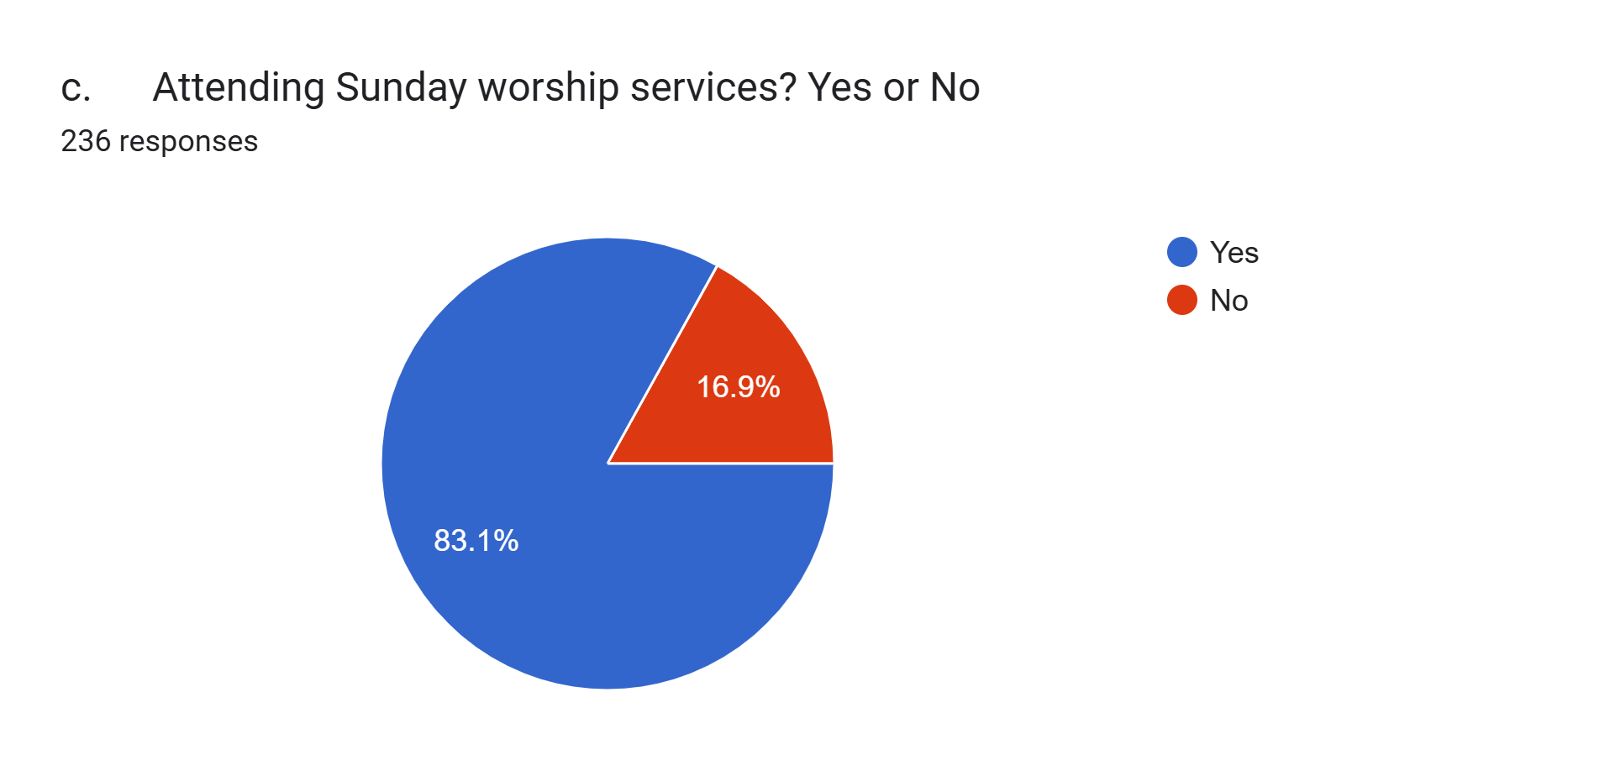
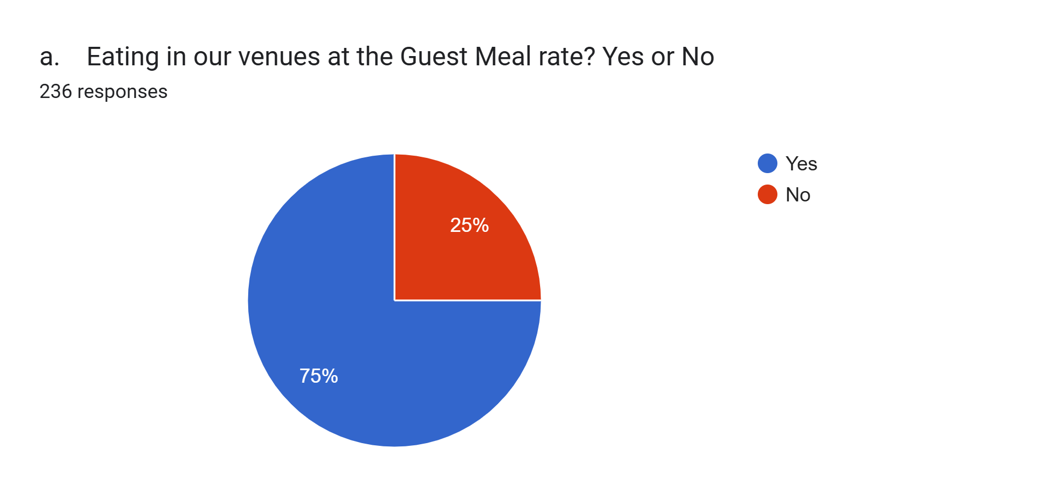
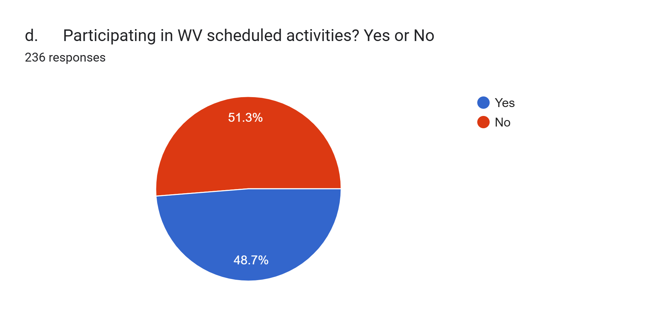
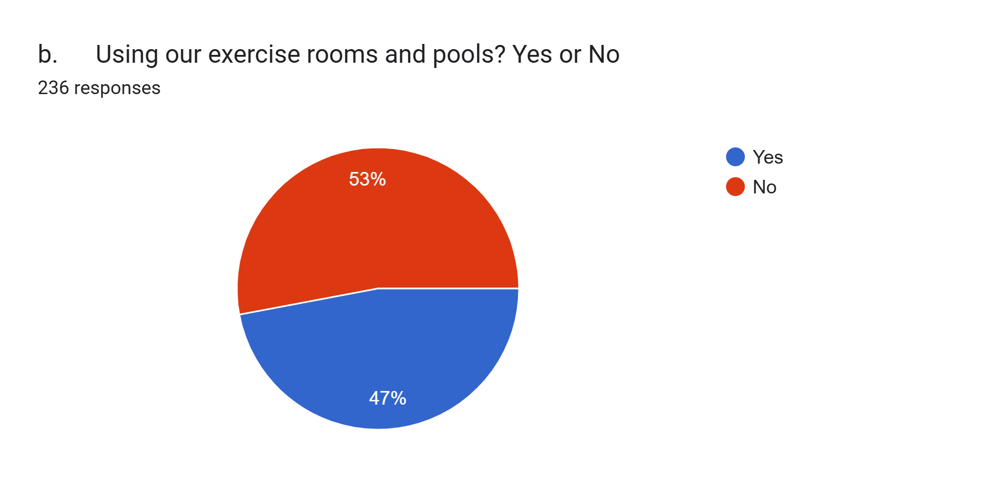
1. At present, people on our independent living wait list (ITWC) are permitted to eat lunch at Waterman Village (WV) paying the guest meal rate, use our exercise rooms and pools, and attend Sunday worship service in the chapel. Are you okay with allowing the following privileges for those who are ITWC members:

Slide 3
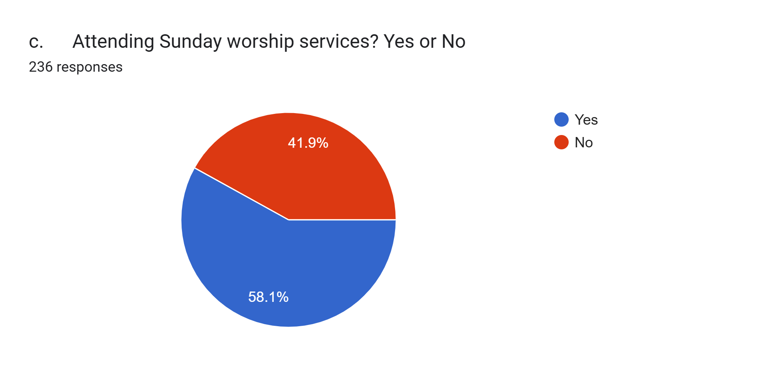
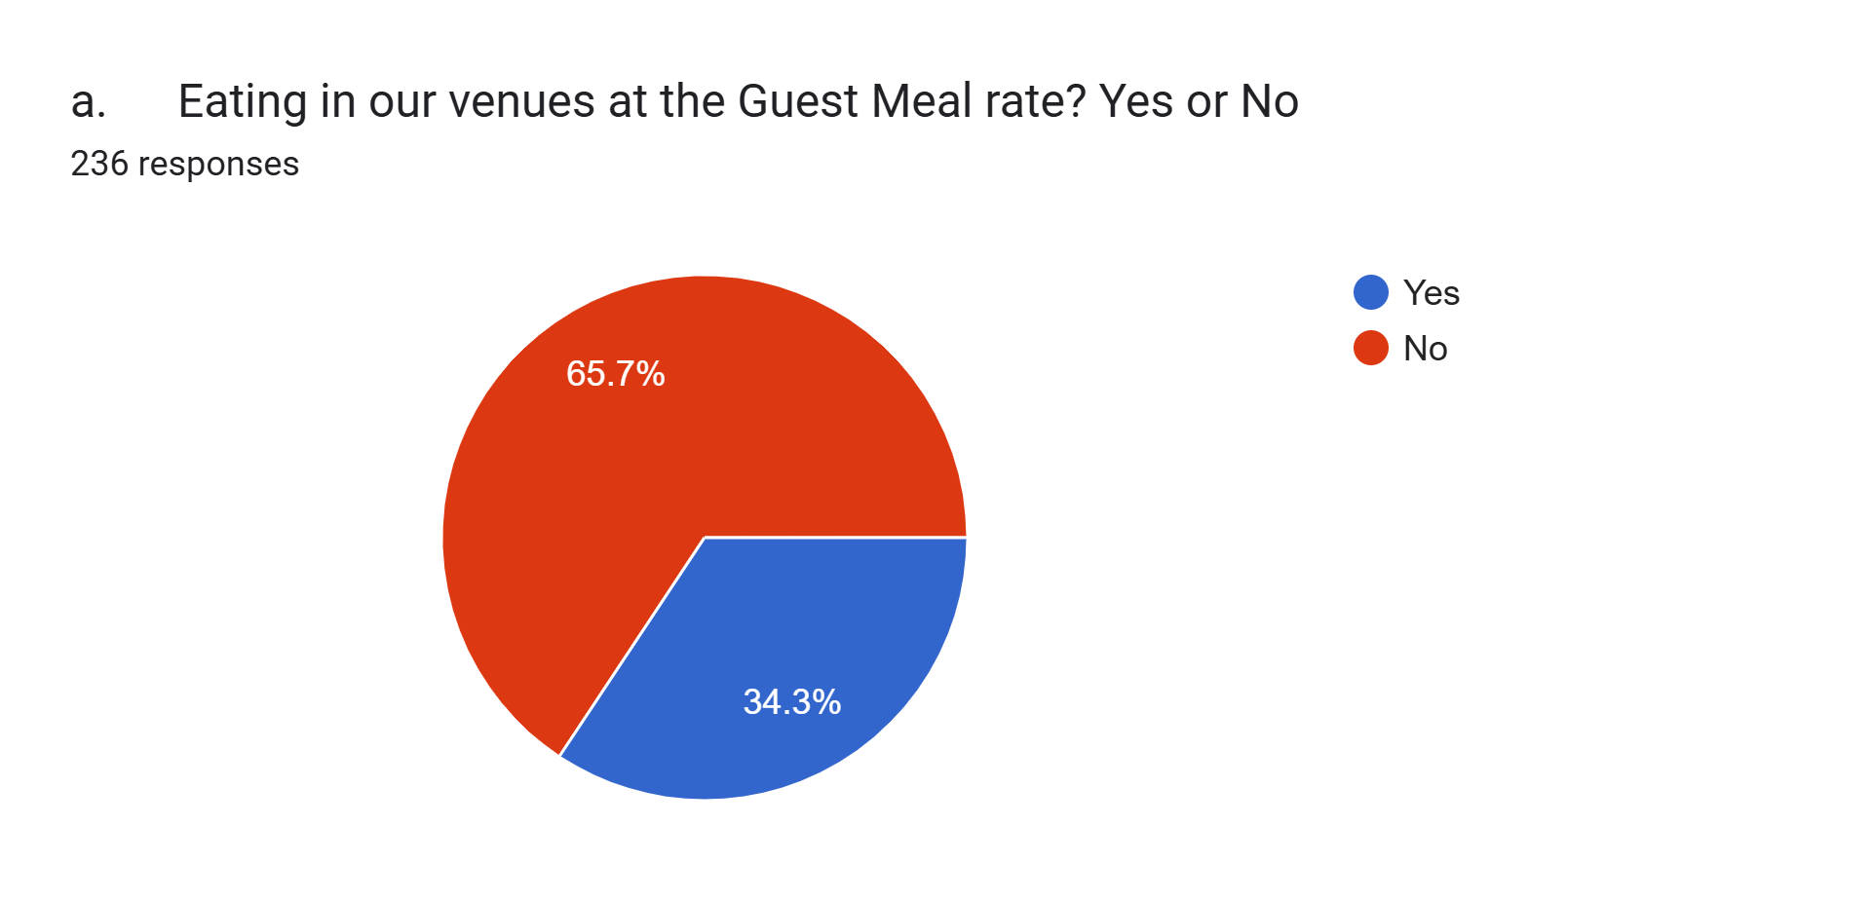
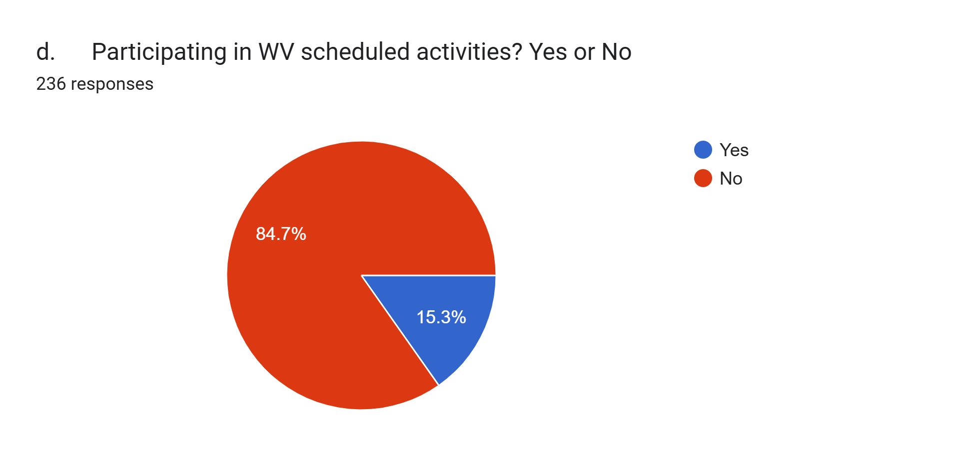
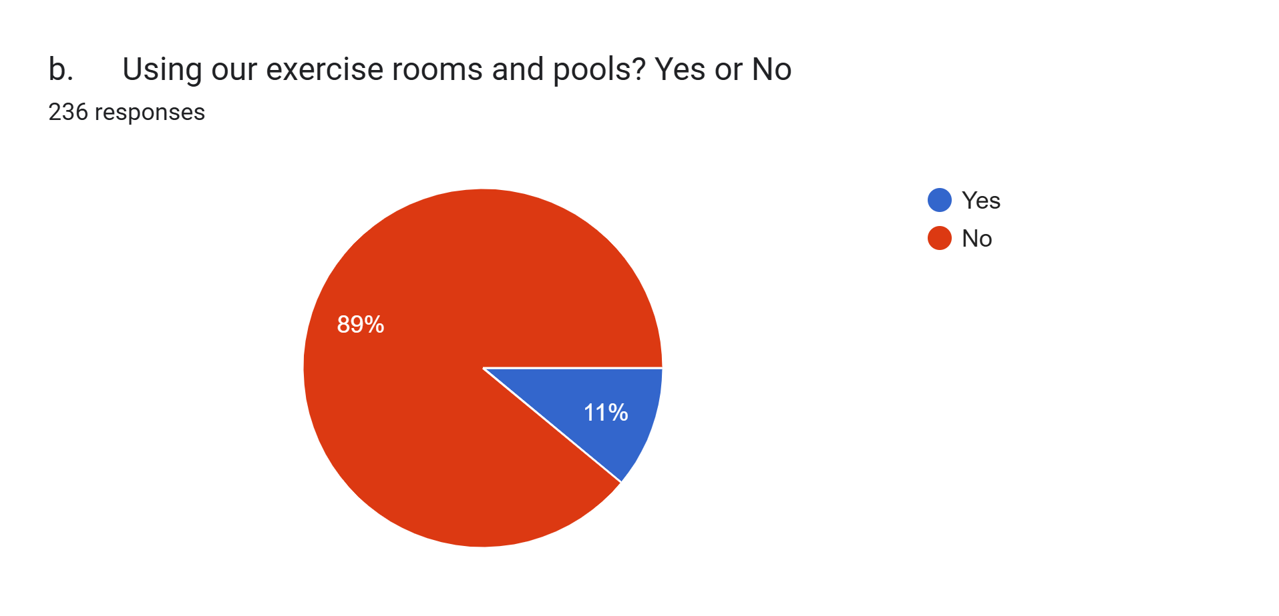
2. Same concept as above only applied to former residents, are you okay with allowing the following privileges for former residents:

Slide 4
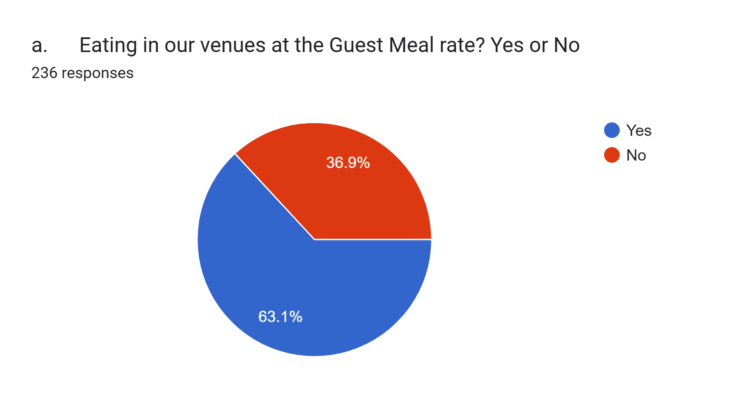
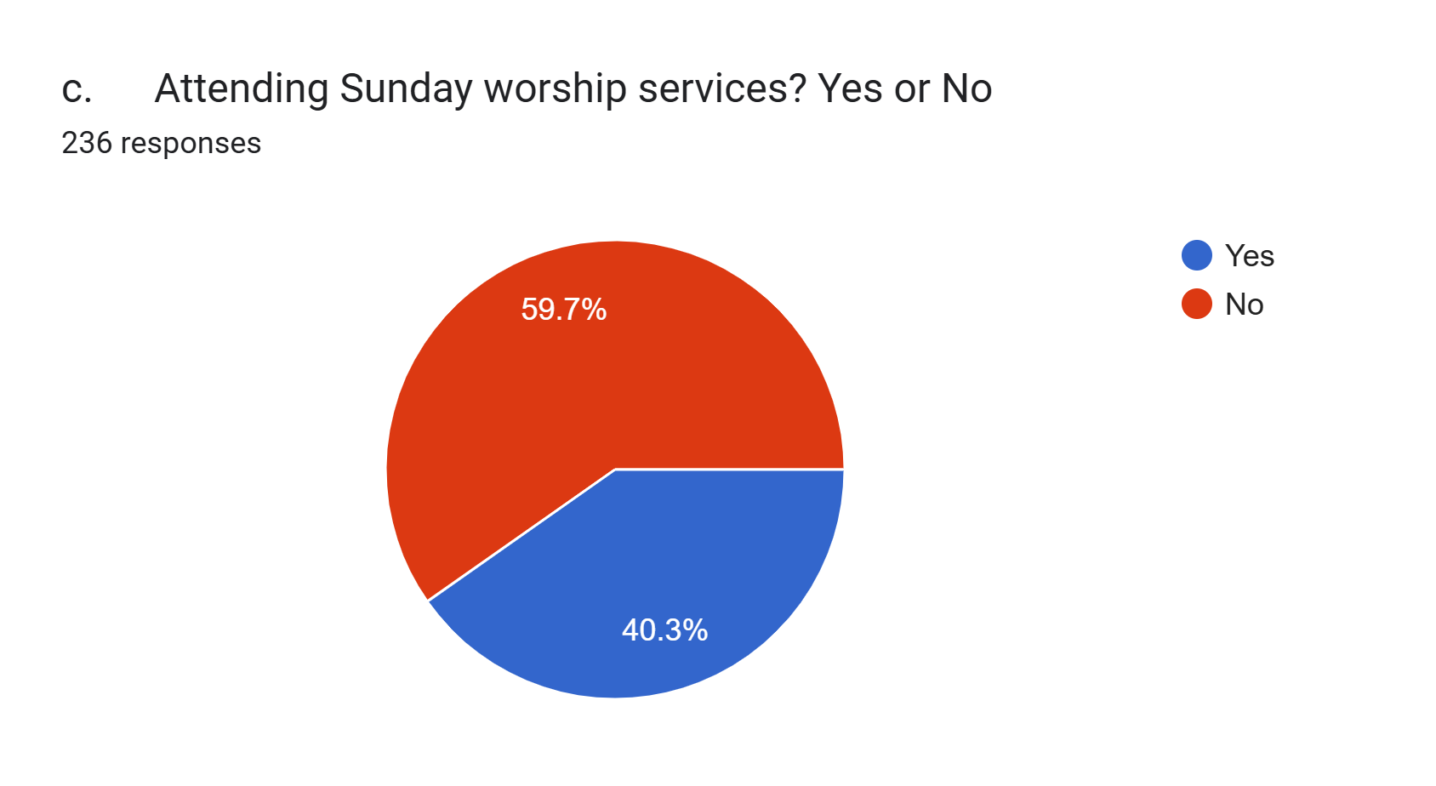
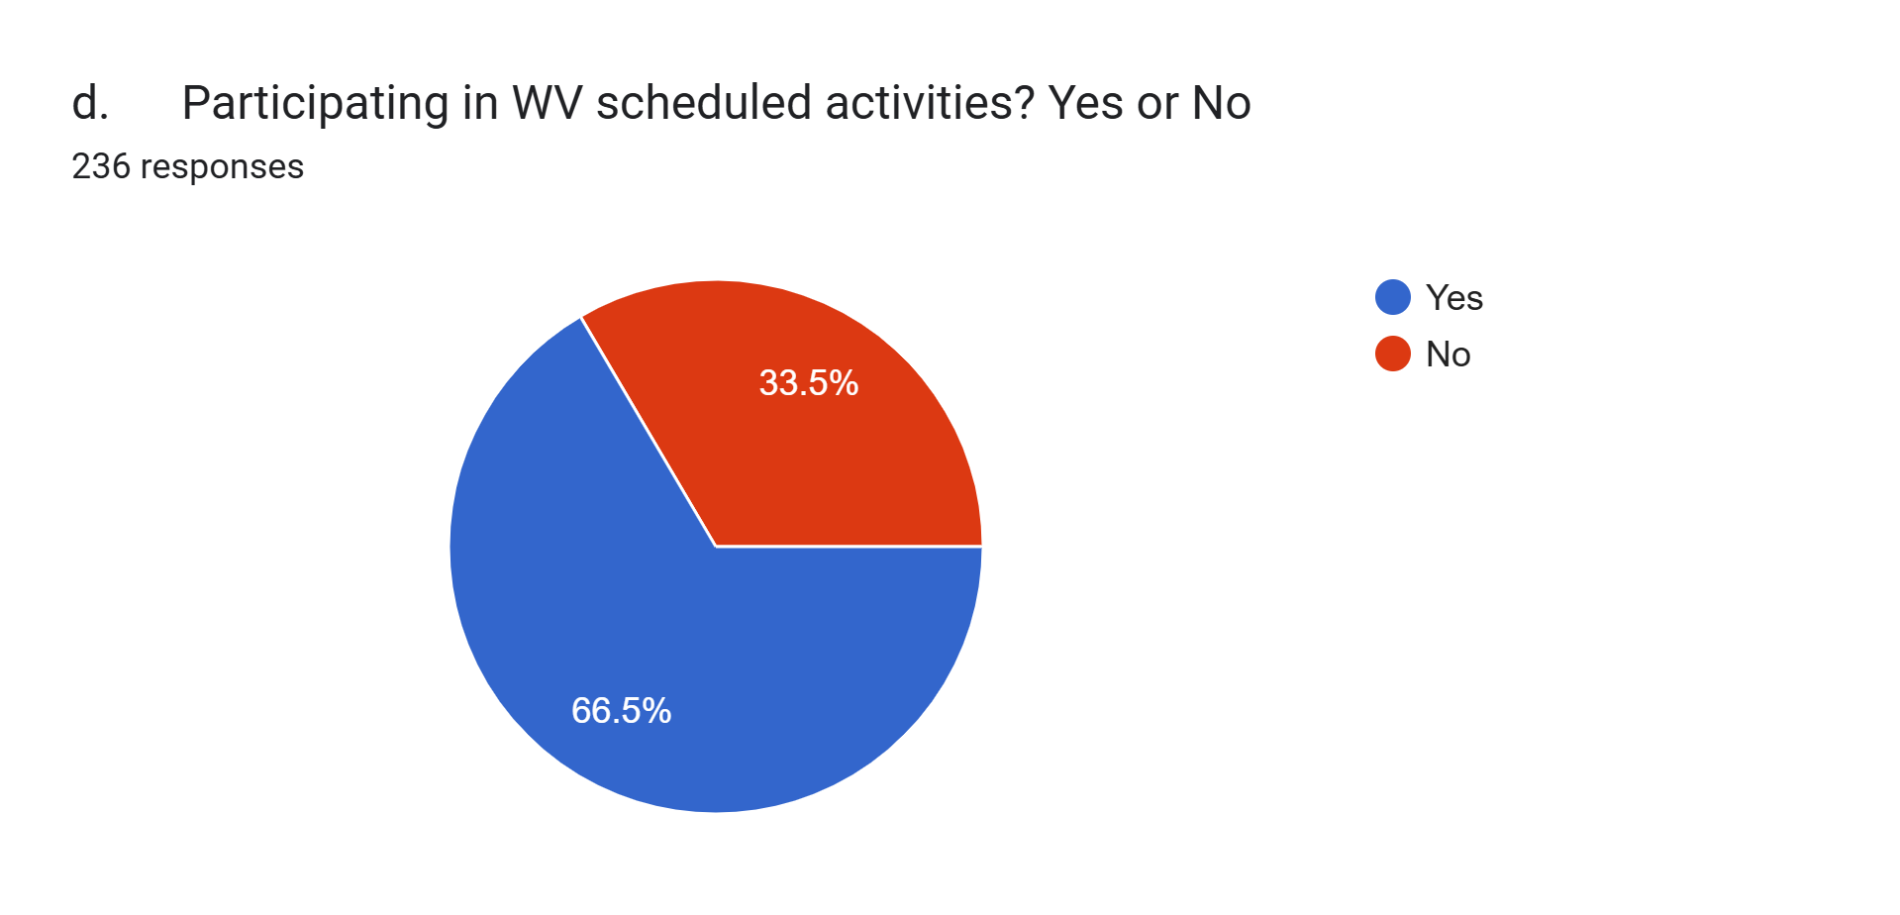
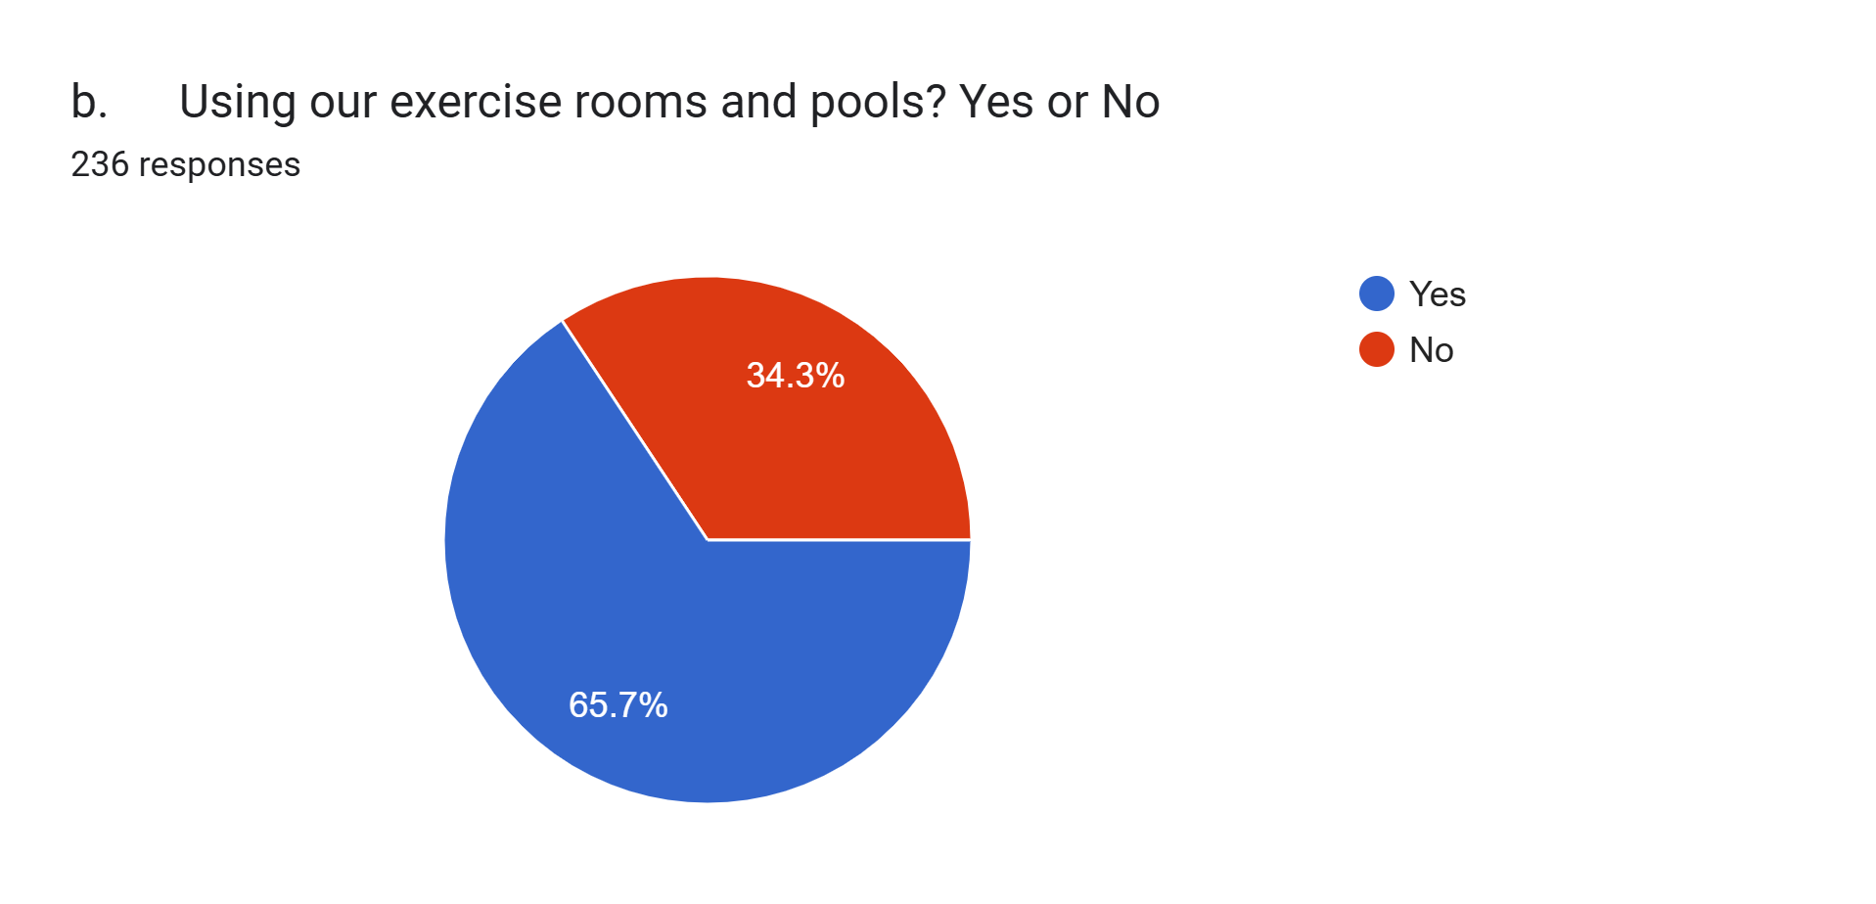
3. Should an existing resident be present when an ITWC member comes on campus for the following:

Slide 5




4. Should an existing resident be present when a former resident comes on campus for the following:

Slide 6


Slide 7


Slide 8
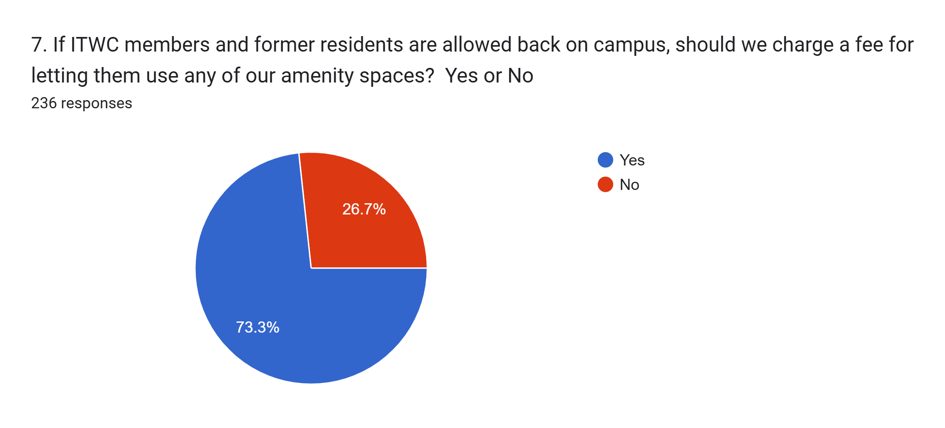

Slide 9




8. Should family members visiting be allowed to do the following without the resident being present:

