Slide 1

How to Fall
SAFELY
Dr. Ashley Jacobs, PT, DPT

Slide 2
Fall Stats
There are 37 million falls per year in the U.S.
There are 700,000 fatal falls per year, globally
As of 2020, 1 in 4 adults over 65 report falling each year
Bathrooms & bedrooms see a high number of falls due to darkness, drowsiness, and tripping hazards

Slide 3
Foods for Falls: Bone Health
Spinach
Kale
Broccoli
Celery
Green beans
Shiitake mushrooms
Wild caught fish
Eggs (good quality)
Flaxseeds
Blueberries
Avocado
Chickpeas

Slide 4
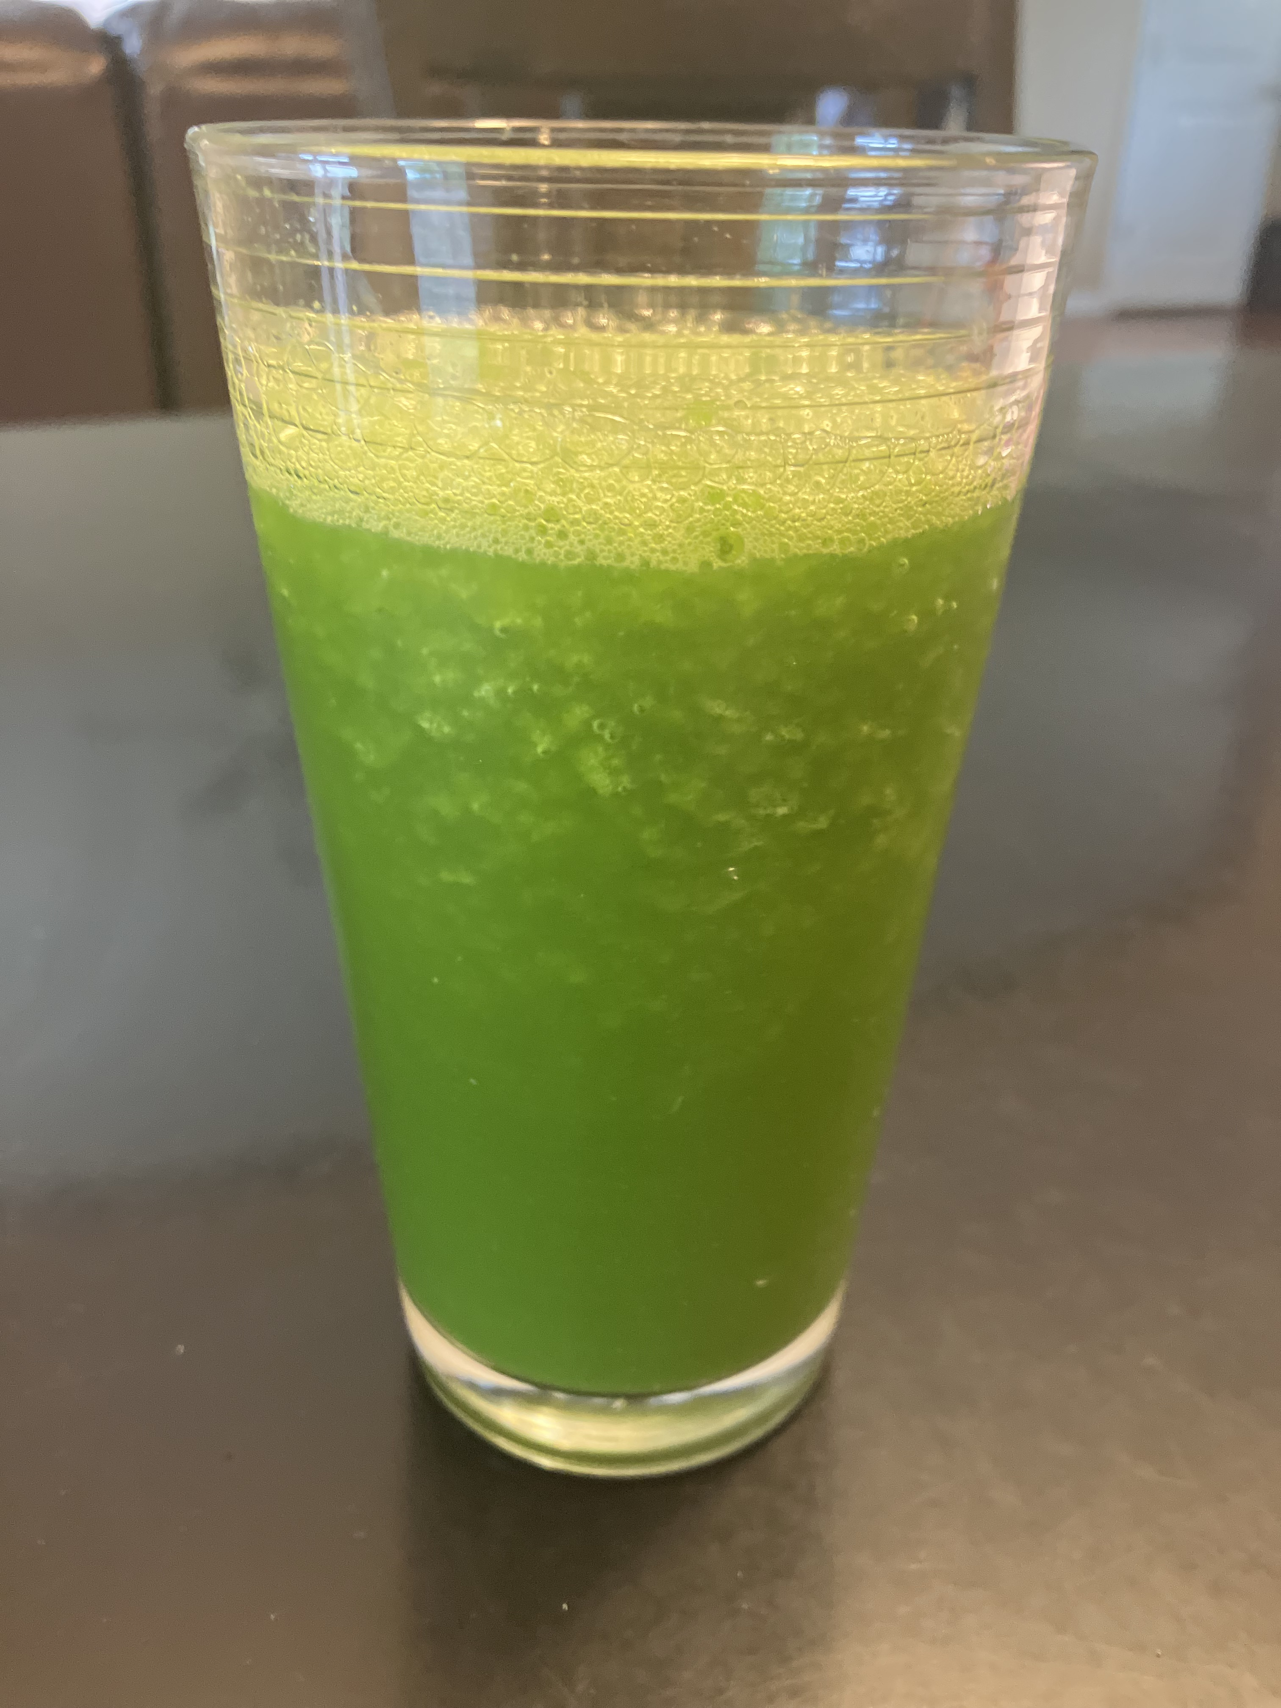
Smoothie Recipe
Ice
Pineapple juice
Frozen strawberries
Frozen mangoes
Frozen fresh spinach
Ground flaxseed
Chia seeds
Honey to taste (optional)

Slide 5
Resistance Exercises
Resist the urge to resist resistance!

Slide 6
How to Fall Safely
https://youtu.be/_x8_9lwQMpw?si=218IURk76dMVQCgS

